Slide 1

GUIs in Java
Module 13

Slide 2
Topics
Swing Dialog boxes
RadioButton Controls
CheckBox Controls
ListView Controls
ComboBox Controls
Slider Controls
TextArea Controls
Menus
The FileChooser Class
Using Console Output to Debug a GUI Application

Slide 3
Swing

Slide 4
Dialog Boxes
A dialog box is a small graphical window that displays a message to the user or requests input.
A variety of dialog boxes can be displayed using the JOptionPane class.
Two of the dialog boxes are:
Message Dialog - a dialog box that displays a message.
Input Dialog - a dialog box that prompts the user for input.

Slide 5

The JOptionPane class is not automatically available to your Java programs.
The following statement must appear before the program’s class header:
import javax.swing.JOptionPane;
This statement tells the compiler where to find the JOptionPane class.

Slide 6
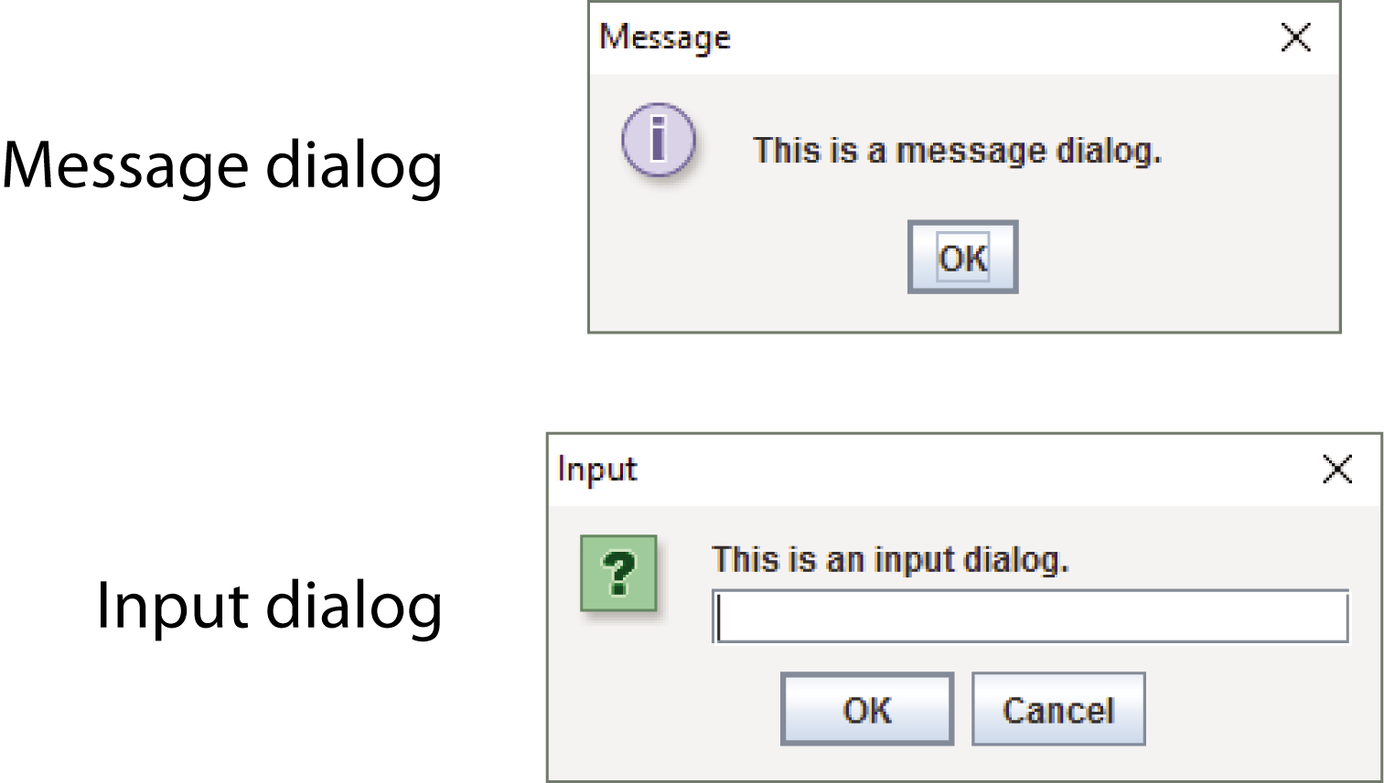
Dialog Boxes
The JOptionPane class provides methods to display each type of dialog box.

Slide 7
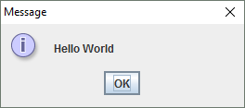
Displaying Message Dialogs
JOptionPane.showMessageDialog method is used to display a message dialog.
JOptionPane.showMessageDialog(null, "Hello World");
Use null as the first argument.
The second argument is the message that is to be displayed.

Slide 8
Displaying Input Dialogs
An input dialog is a quick and simple way to ask the user to enter data.
The dialog displays a text field, an OK button and a Cancel button.
If OK is pressed, the dialog returns the user’s input.
If Cancel is pressed, the dialog returns null.

Slide 9
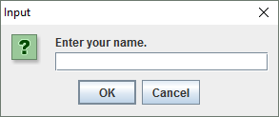
Displaying Input Dialogs
String name;
name = JOptionPane.showInputDialog("Enter your name.");
The argument passed to the method is the message to display.
If the user clicks on the OK button, name references the string entered by the user.
If the user clicks on the Cancel button, name references null.

Slide 10

Dialog Boxes
A program that uses JOptionPane does not automatically stop executing when the end of the main method is reached.
Java generates a thread, which is a process running in the computer, when a JOptionPane is created.
If the System.exit method is not called, this thread continues to execute.

Slide 11
Dialog Boxes
The System.exit method requires an integer argument.
System.exit(0);
This argument is an exit code that is passed back to the operating system.
This code is usually ignored; however, it can be used outside the program:
to indicate whether the program ended successfully or as the result of a failure.
The value 0 traditionally indicates that the program ended successfully.

Slide 12

Converting a String to a Number
The JOptionPane’s showInputDialog method always returns the user's input as a String
A String containing a number, such as "127.89", can be converted to a numeric data type.

Slide 13

JavaFX Controls

Slide 14
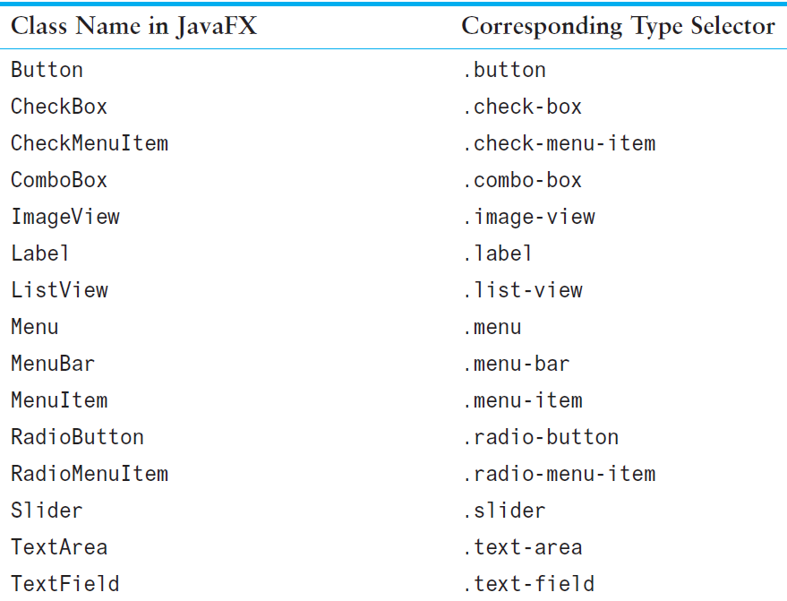
Type Selectors

Slide 15
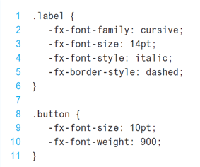
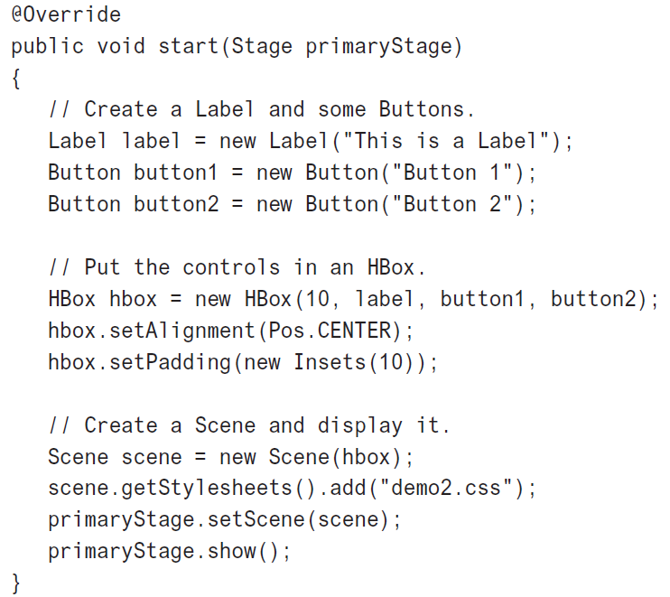


Slide 16
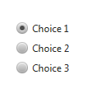
RadioButton Controls
RadioButton controls allow the user to select one choice from several possible options.

Slide 17
RadioButton Controls
The RadioButton class is in the javafx.scene.control package. RadioButton radio1 = new RadioButton("Choice 1"); RadioButton radio2 = new RadioButton("Choice 2"); RadioButton radio3 = new RadioButton("Choice 3");

Slide 18

RadioButton Controls
RadioButton controls are normally grouped together in a toggle group.
Only one of the RadioButton controls in a toggle group may be selected at any time.
Clicking on a RadioButton selects it and automatically deselects any other RadioButton in the same toggle group.

Slide 19
RadioButton Controls
To create a toggle group, you use the ToggleGroup class, which is in the javafx.scene.control package: ToggleGroup myToggleGroup = new ToggleGroup();
After creating a ToggleGroup object, you call each RadioButton control’s setToggleGroup method to add them to the ToggleGroup.

Slide 20
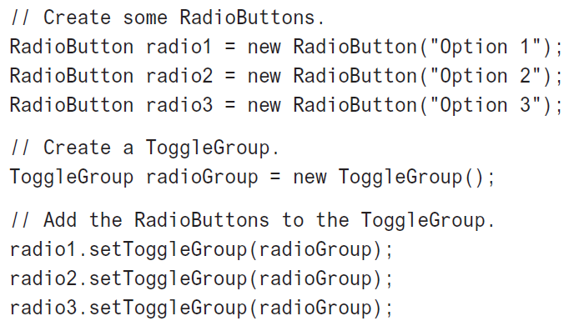
RadioButton Controls

Slide 21
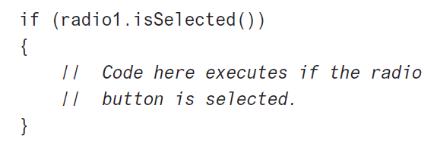
RadioButton Controls
To determine whether a RadioButton is selected, you call the RadioButton class’s isSelected method.

Slide 22

RadioButton Controls
You usually want one of the RadioButtons in a group to be initially selected.
You can select a RadioButton in code with the RadioButton class’s setSelected method: radio1.setSelected(true);

Slide 23
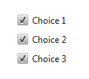
CheckBox Controls
CheckBox controls allow the user to make yes/no or on/off selections.

Slide 24
CheckBox Controls
The CheckBox class is in the javafx.scene.control package. CheckBox choice1 = new CheckBox("Choice 1"); CheckBox choice2 = new CheckBox("Choice 2"); CheckBox choice3 = new CheckBox("Choice 3");

Slide 25
CheckBox Controls
To determine whether a CheckBox is selected, you call the CheckBox class’s isSelected method:
if (check1.isSelected())
{
// Code here executes if the check
// box is selected.
}

Slide 26
CheckBox Controls
You can select a CheckBox in code with the CheckBox class’s setSelected method: check1.setSelected(true);

Slide 27
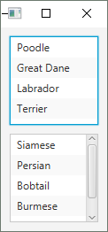
ListView Controls
The ListView control displays a list of items and allows the user to select one or more items from the list.

Slide 28
ListView Controls
The ListView class is in the javafx.scene.control package. ListView<String> dogListView = new ListView<>();
Adding items to the ListView: dogListView.getItems().addAll( "Poodle", "Great Dane", "Labrador", "Terrier");

Slide 29
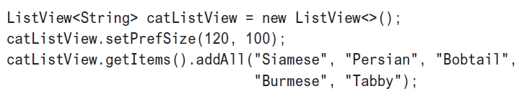
ListView Controls
Creating a ListView with a preferred size:

Slide 30
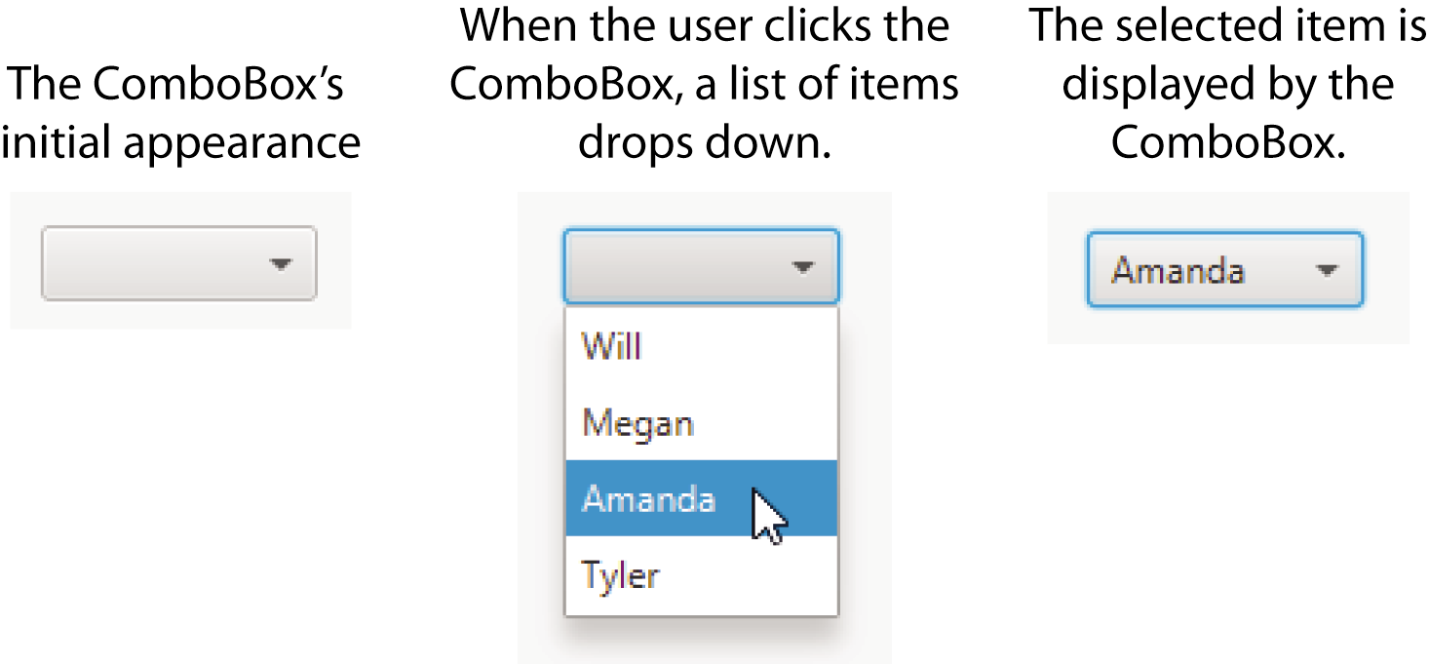
ComboBox Controls

Slide 31
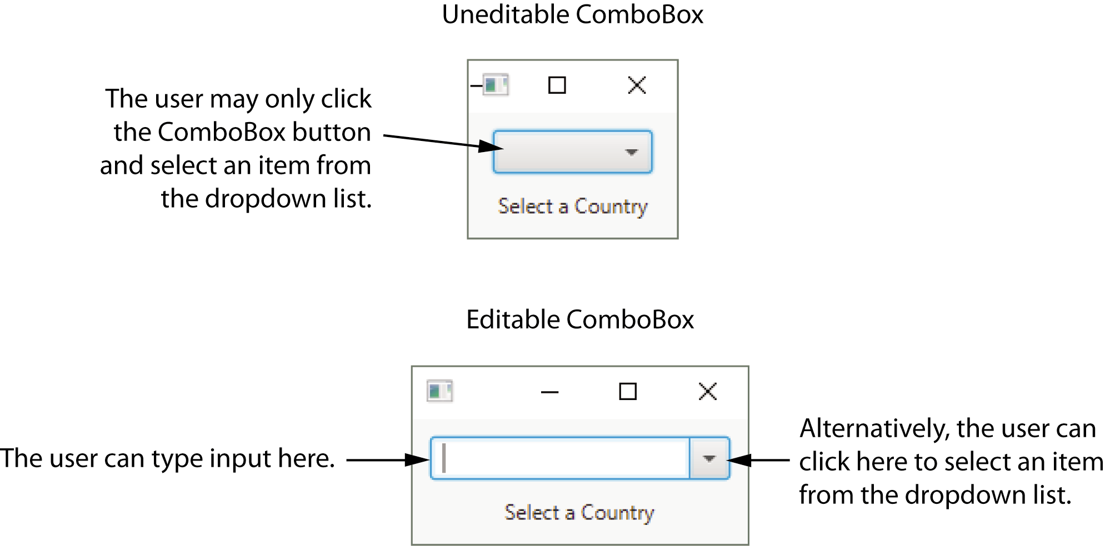
ComboBox Controls

Slide 32
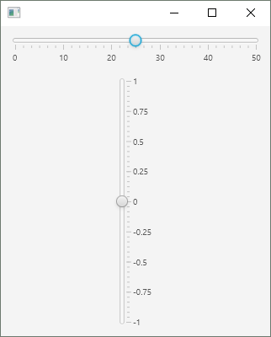
Slider Controls
A Slider allows the user to graphically adjust a number within a range.
Sliders are created from the Slider class (in the javafx.scene.control package)
They display an image of a “slider knob” that can be dragged along a track.

Slide 33
Slider Controls
The Slider class has two constructors. No-arg: Slider slider = new Slider();
Creates a Slider with a minimum value of 0, and a maximum value of 100.
The Slider’s initial value will be set to 0, and no tick marks will be displayed.

Slide 34
Slider Controls
The second constructor accepts three double arguments:
the minimum value
the maximum value
the initial value Slider slider = new Slider(0.0, 50.0, 25.0);

Slide 35
TextArea Controls
A TextArea is a multiline TextField that can accept several lines of text input or display several lines of text.
The TextArea class (in the javafx.scene.control package) has two constructors. TextArea textArea = new TextArea(); TextArea textArea = new TextArea("This is the initial text.");

Slide 36
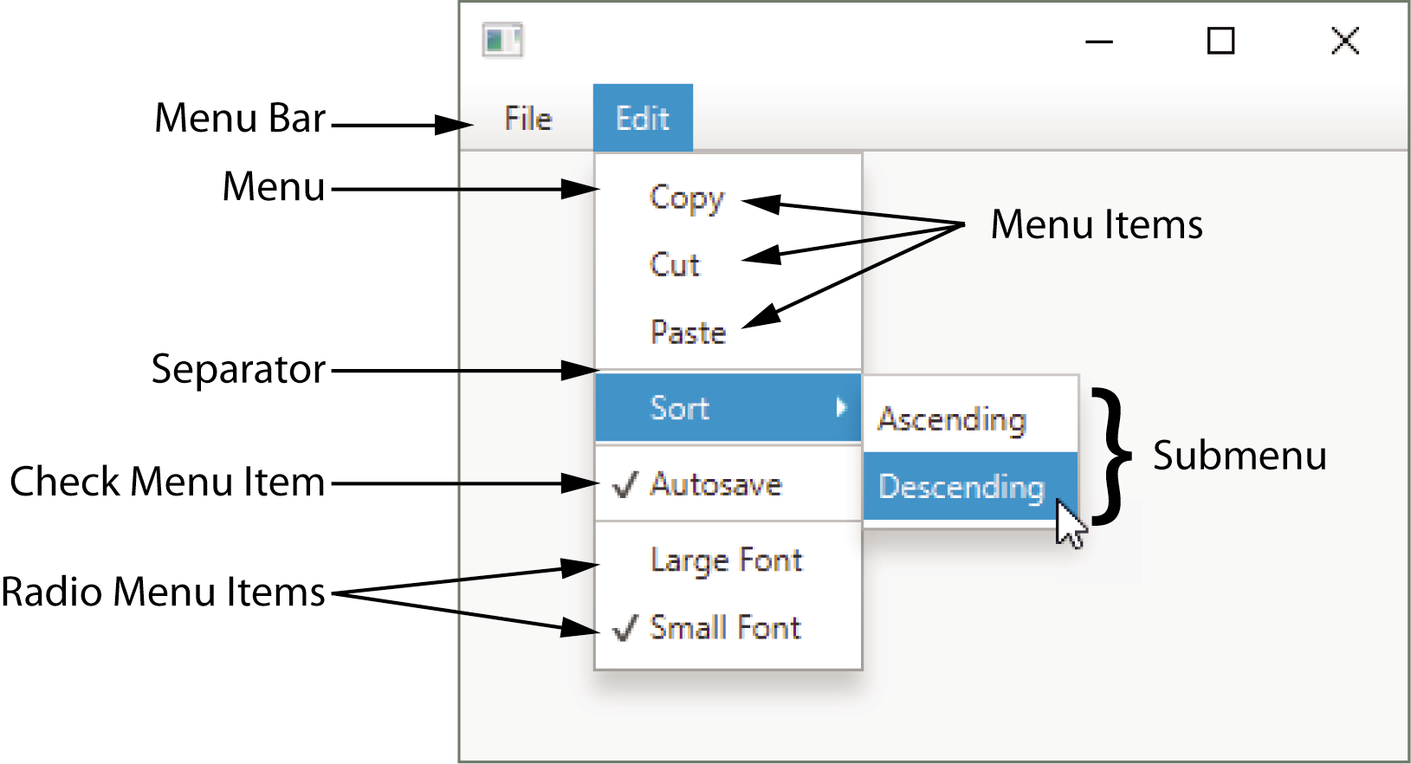
Menus
A menu system is a collection of commands organized in one or more drop-down menus.

Slide 37
Using Console Output to Debug a GUI
Use System.out.println() to display variable values, etc. in the console as your application executes to identify logic errors // For debugging, display the text entered, and // its value converted to a double.
System.out.println("Reading " + str + " from the text field."); System.out.println("Converted value: " + Double.parseDouble(str));

Slide 38

End of Lecture

